Slide 1
CANTEEN MANAGEMENT SYSTEM
Presented By: Batch 06
19B01A05C6 NANDIKAM LAKSHMI SAI AKHILA
19B01A0599 PENMETSA SUBHA SAI LAKSHMI SRIHITHA
19B01A0566 KARRA TARUNI
19B01A0570 KOCHERLA SANJANA BHANU
20B05A0512 PARASA JAHNAVI
Guided By: Mr P. Sunil Sir

Slide 2
PROBLEM STATEMENT
Problem Statement-
The project online canteen system helps the users to book their food earlier.
The users have to book their food on the e-menu card.
As soon as they book their food the order will be sent to the manager and then to chef for preparing it.

Slide 3
OBJECTIVES
This way will ease the ordering food in a canteen. The food will be ready in advance and the customers need not to wait near the delivery place.
It is also advantage for small and large scale canteens.
More flexible
Need not wait for hours to get food. The digitalisation of the canteen system will be helpful in providing the better service to the users and the time consumption will be reduced.
Portable
Reusable
High end security

Slide 4
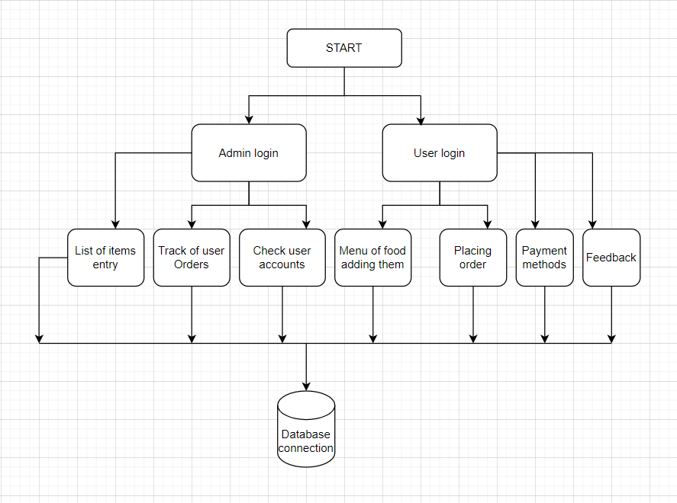
MODULES
Register Page
Login Page
Menu Access System
Order Retrieval System
Tickets (Feedback) and Logout

Slide 5
MODULE : 1
Register Page
Here the details of users are entered into the system database (user database). This page is created by HTML and CSS also CSS bootstrap frame work.
Details of user will be Name, Username, Password, Contact.

Slide 6
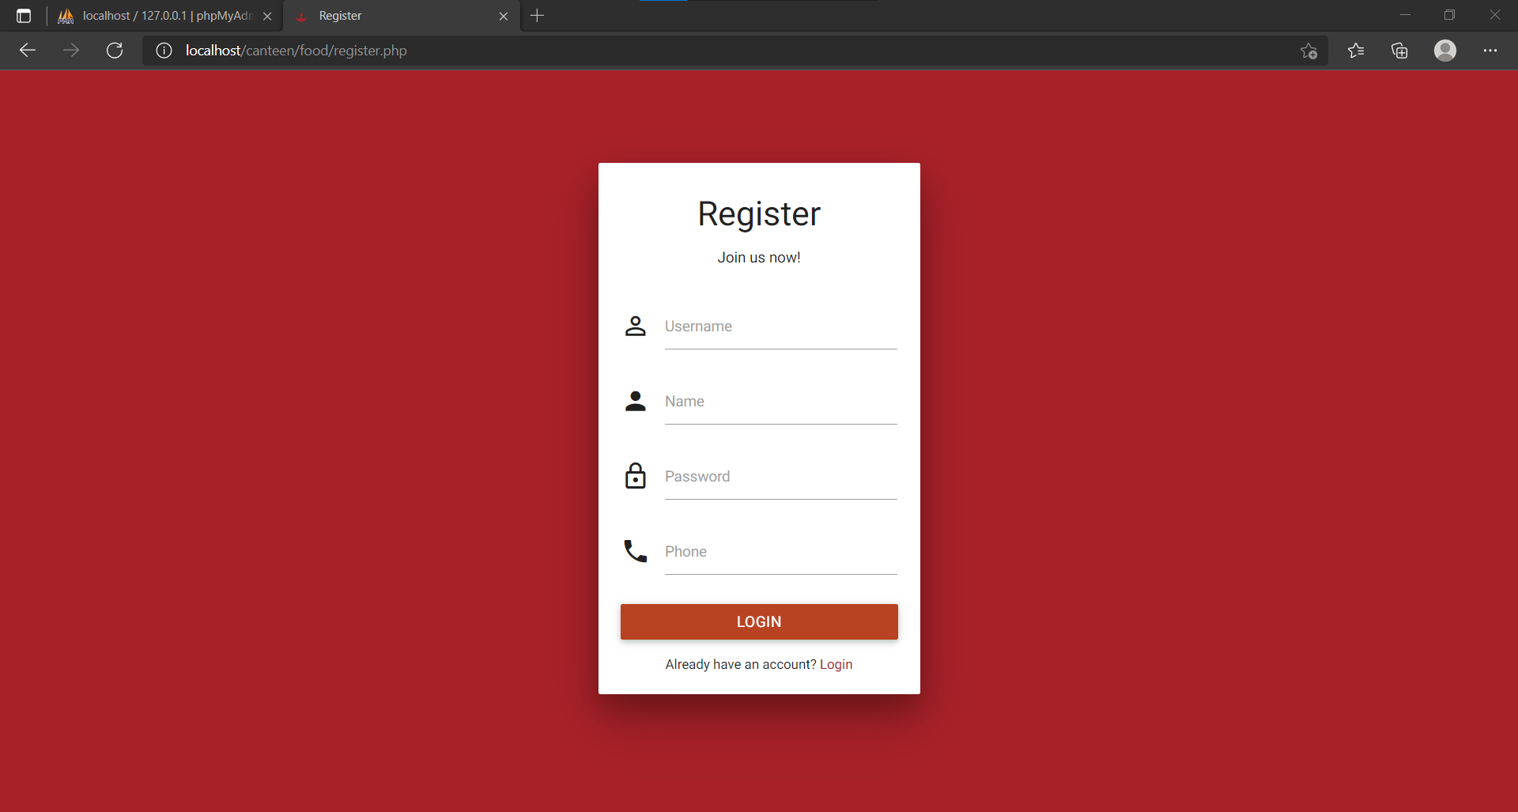

Slide 7
MODULE : 2
Login Page
After Registration , Login page is redirected where username and password are given.
On login it redirects to customer or admin account based on credentials.

Slide 8
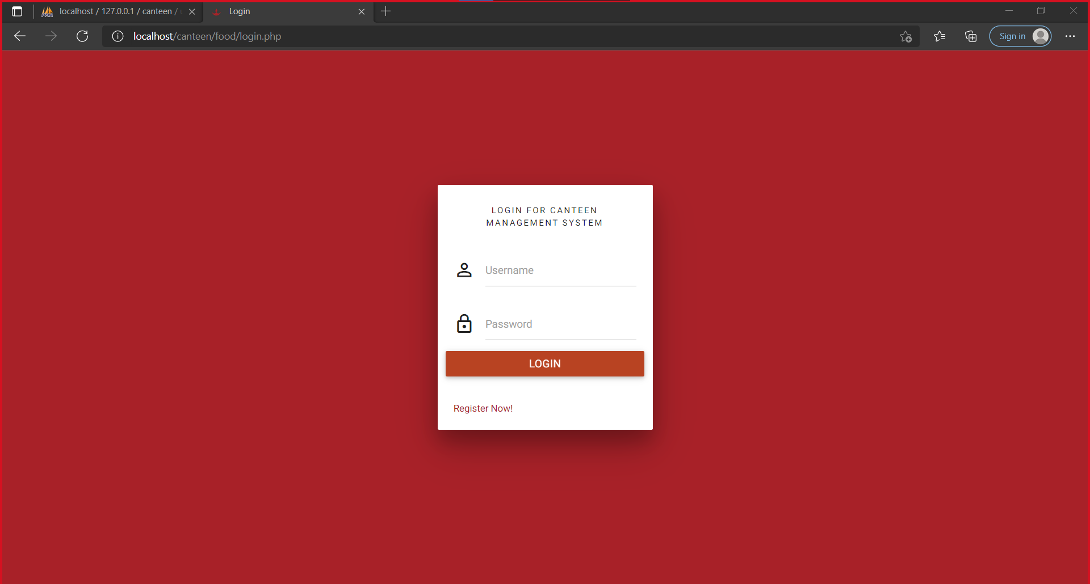

Slide 9
MODULE : 3
Menu Access System
The menu management system will be available for both canteen employees and canteen customers allow them to manage the menu or go through menu of the web ordering system. The functions afforded by the menu management system provide the user with the ability to, using a graphical interface:
Admin:
Add a new food item to/from the menu along with price.
Add a update option for a given food item.
User:
Menu is displayed to the user for ordering items with item name, quantity, price.

Slide 10
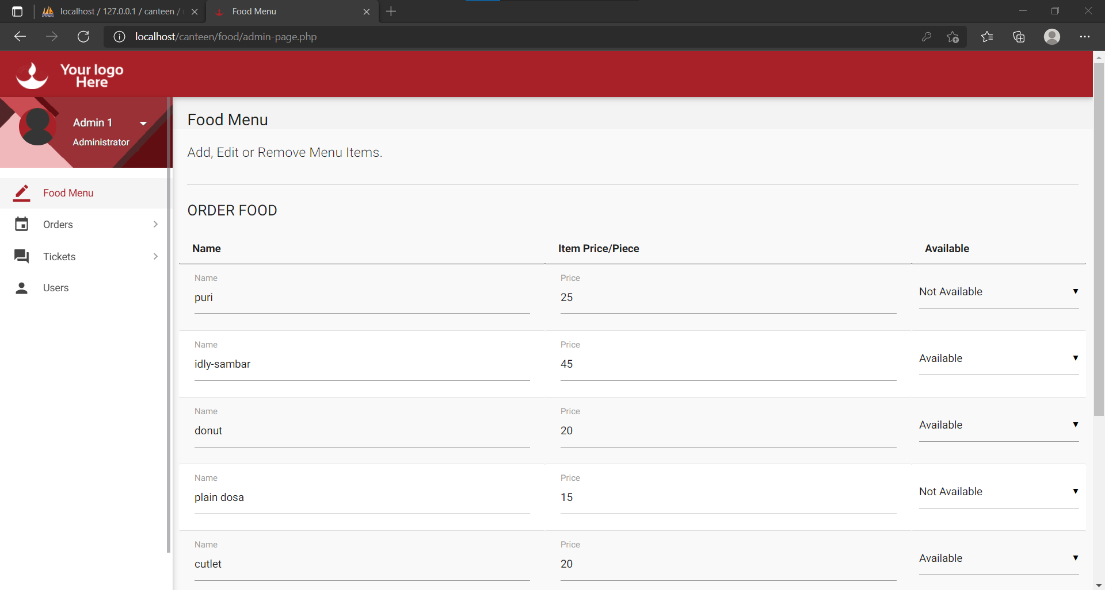

Slide 11
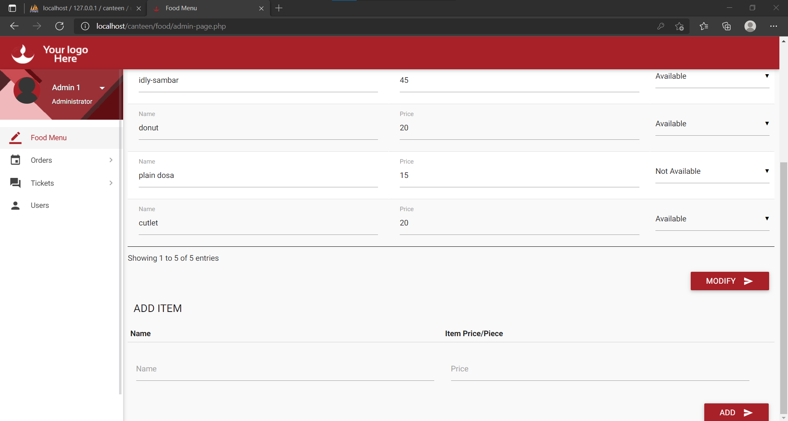

Slide 12
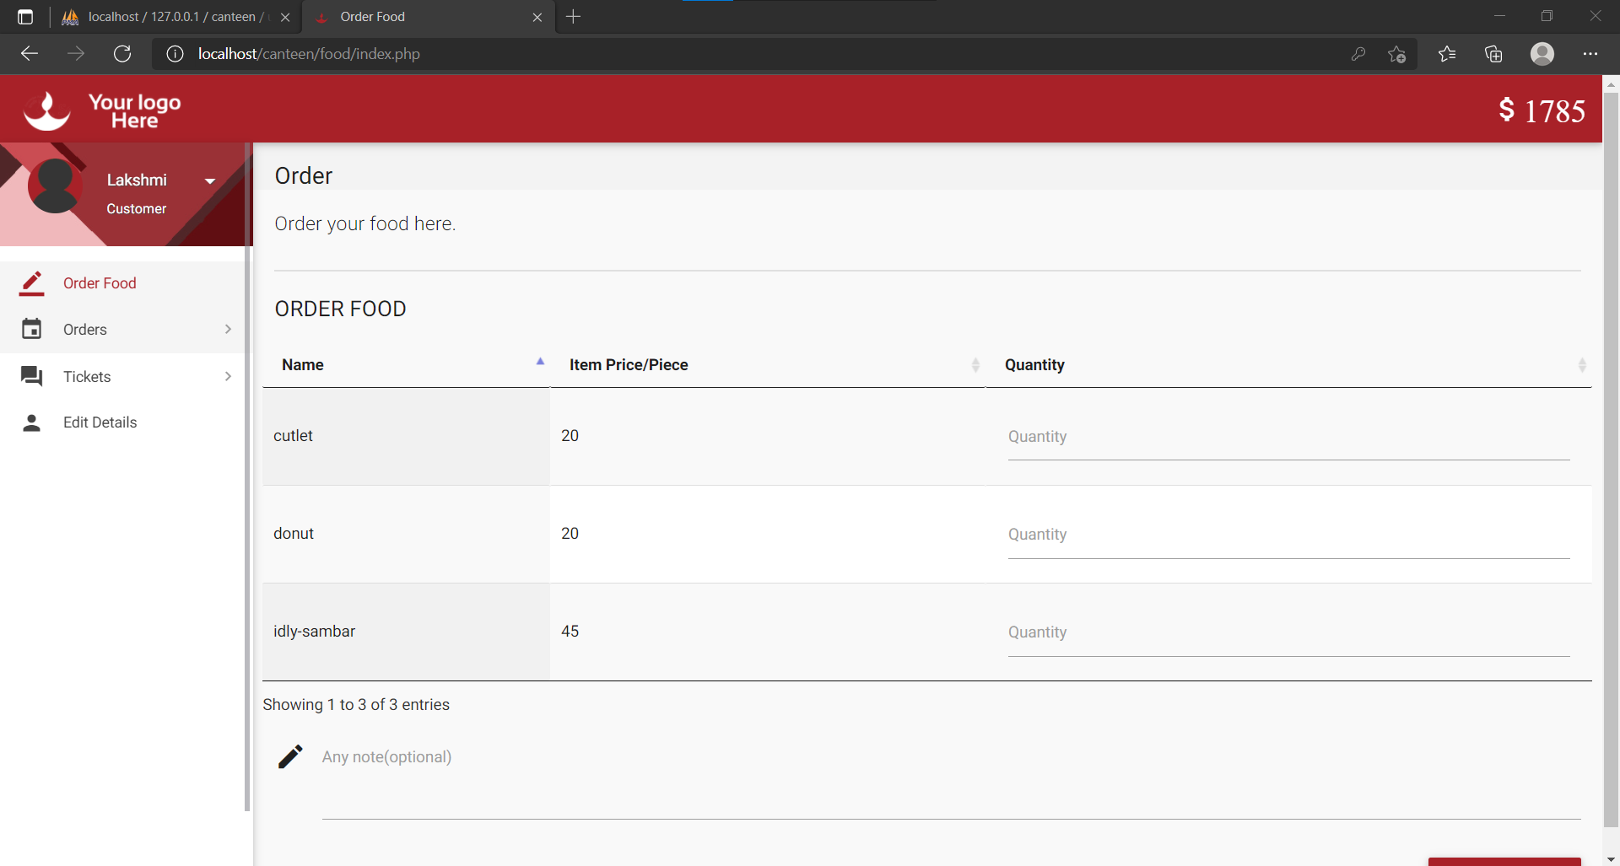

Slide 13
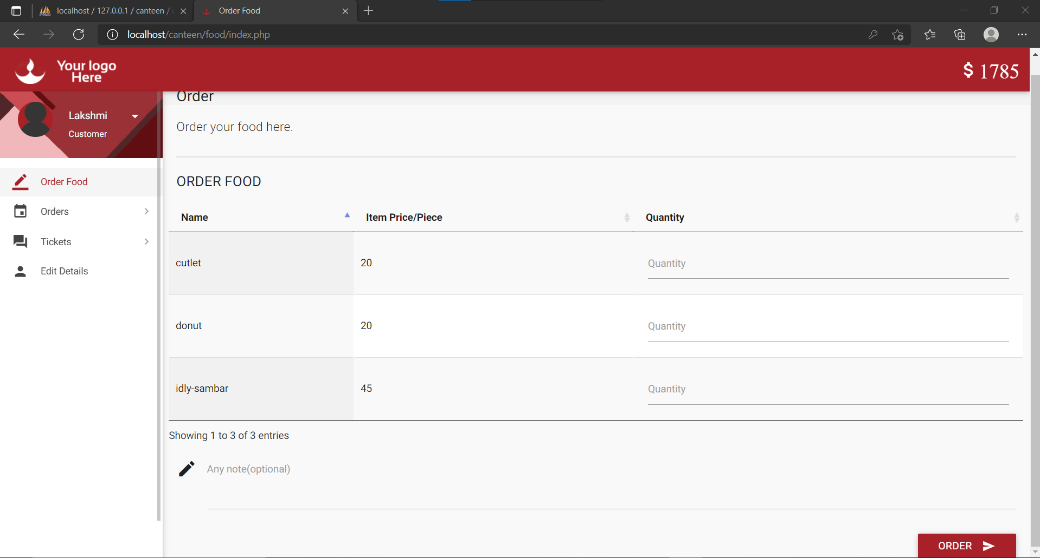

Slide 14
MODULE : 4
Order Retrieval System
Of the three components, the order retrieval system is functionally the simplest. Like the menu management system, it is designed to be used by both canteen employees and customers, and provides the following functions:
Admin:
Retrieve new orders from the database.
Display the orders in an easily readable, graphical way.
Mark an order as having been processed and remove it from the list of active orders.
User:
Place Order
Display the orders in an easily readable, graphical way.
Cancel Order
View an order as having been processed and remove it from the list of active orders.

Slide 15
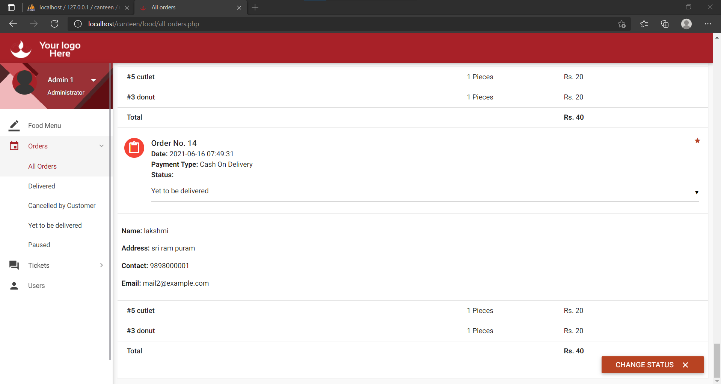

Slide 16
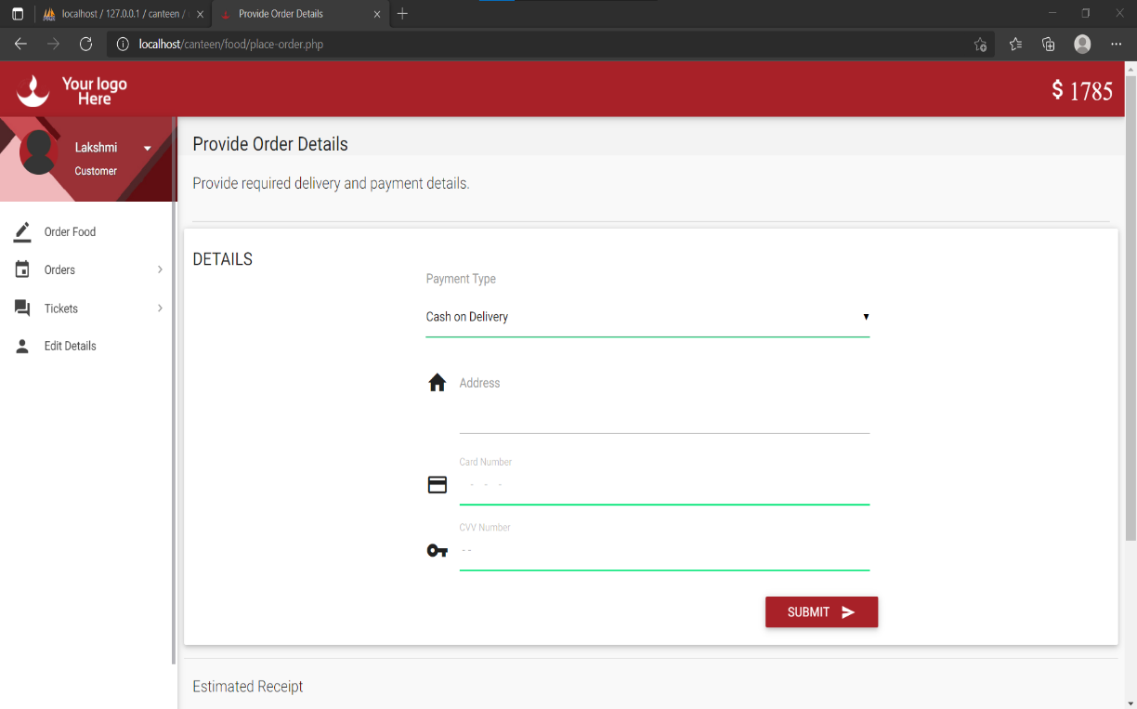

Slide 17
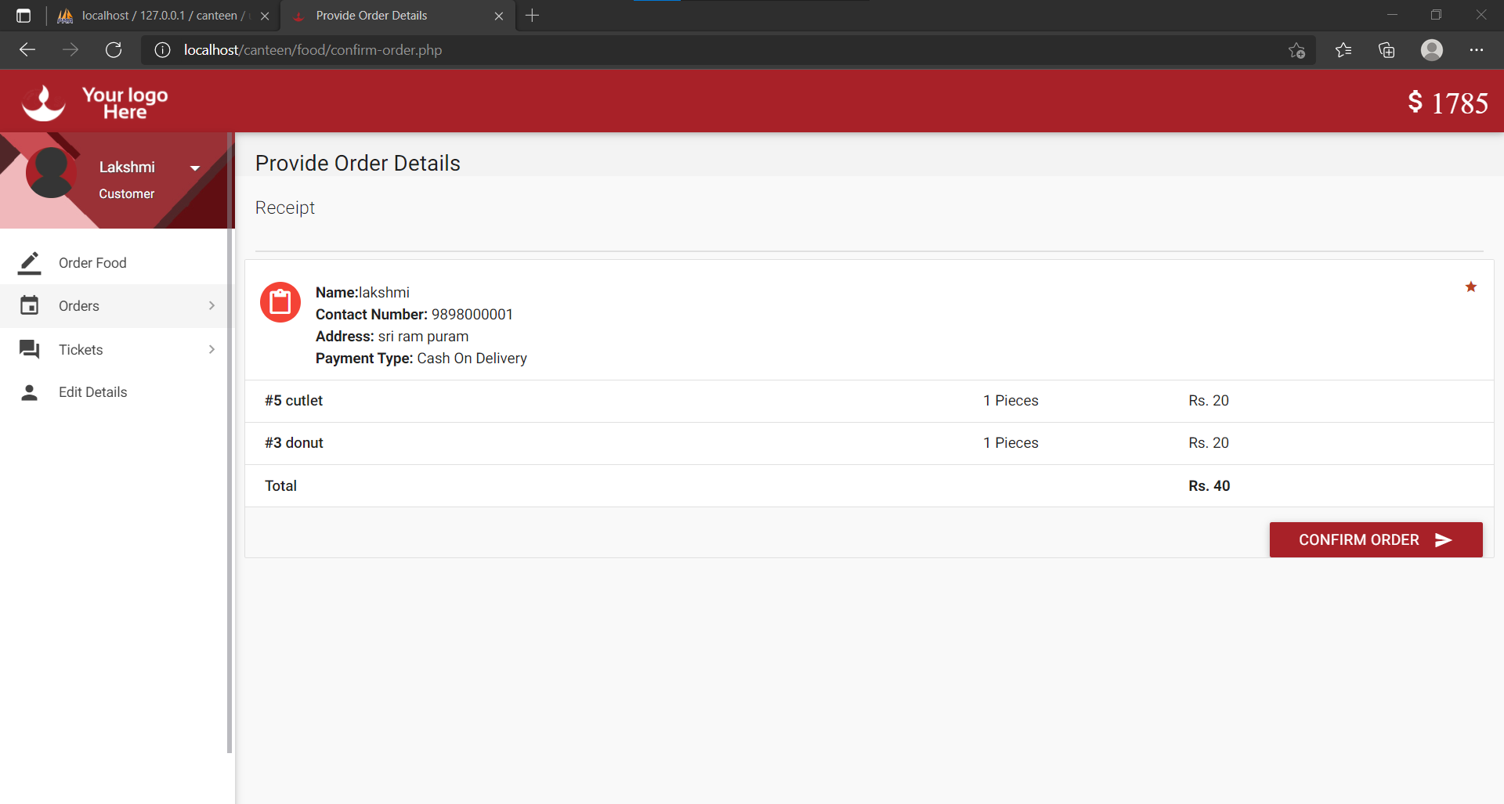

Slide 18
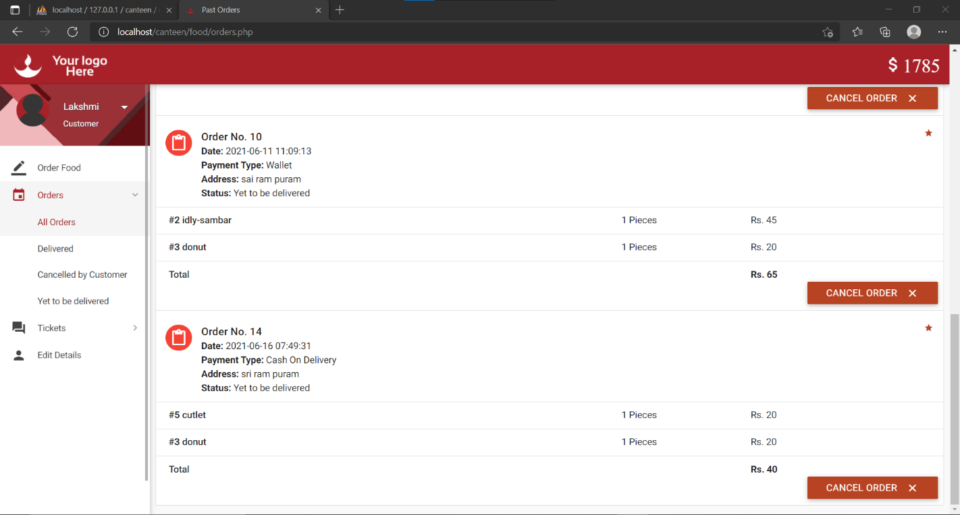

Slide 19
MODULE : 5
Tickets and Logout
Tickets are like Feedback or queries related to canteen functionalities that user opens and are answered by the Admin. Once Order placed and delivered user logs out.

Slide 20
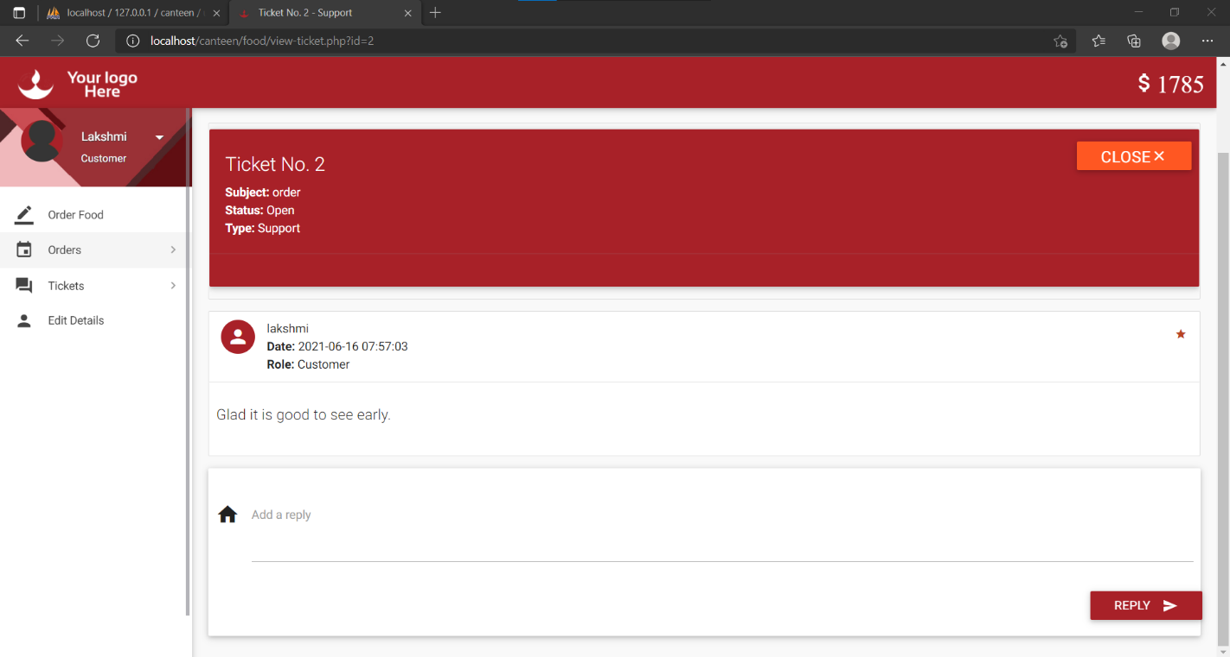

Slide 21
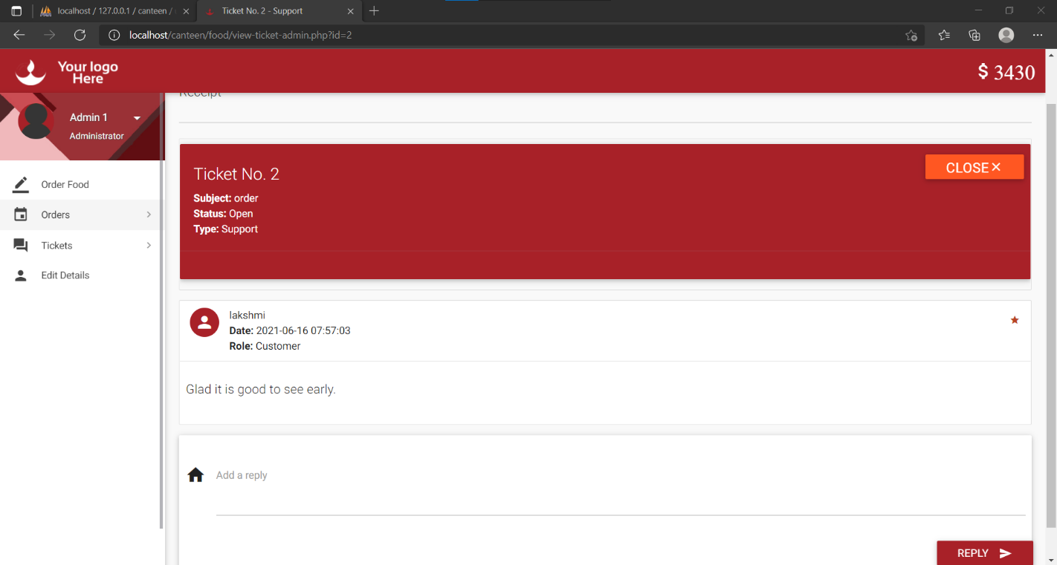

Slide 22
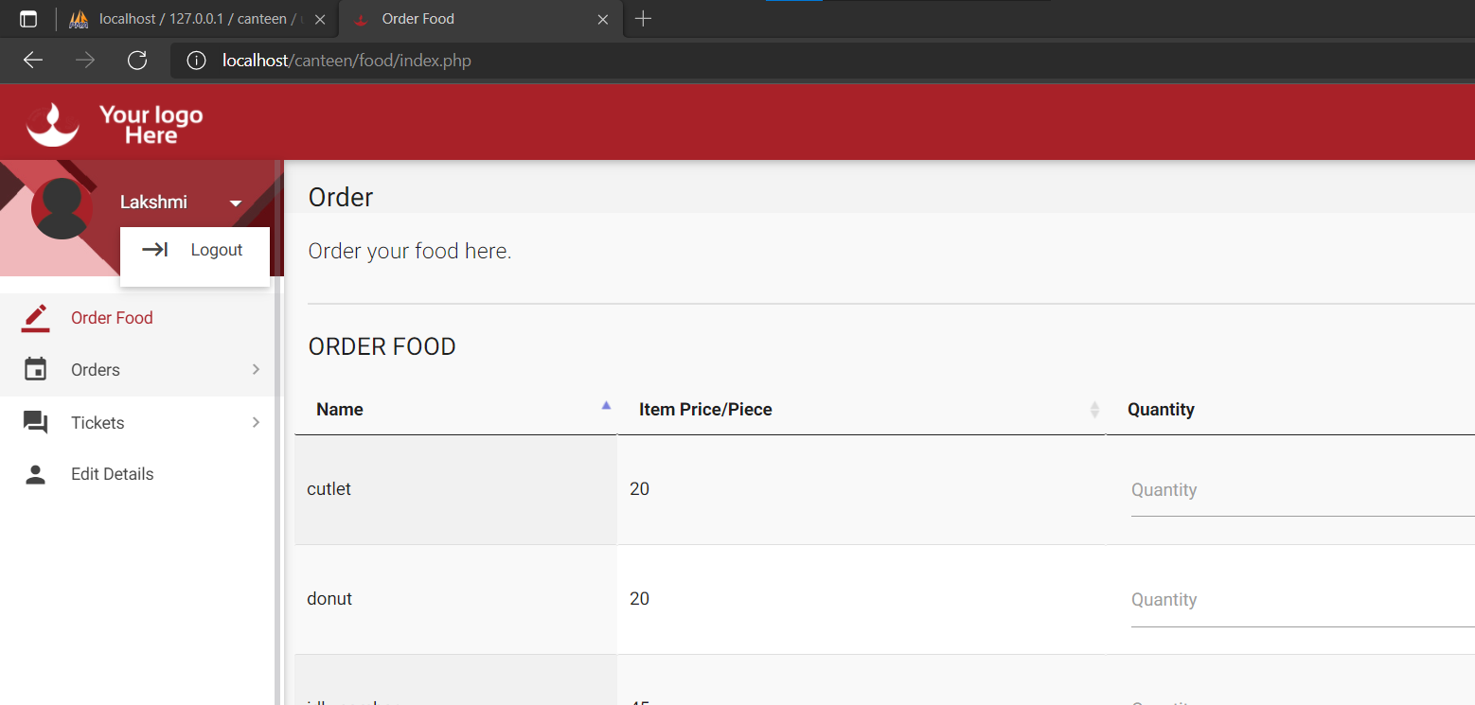

Slide 23
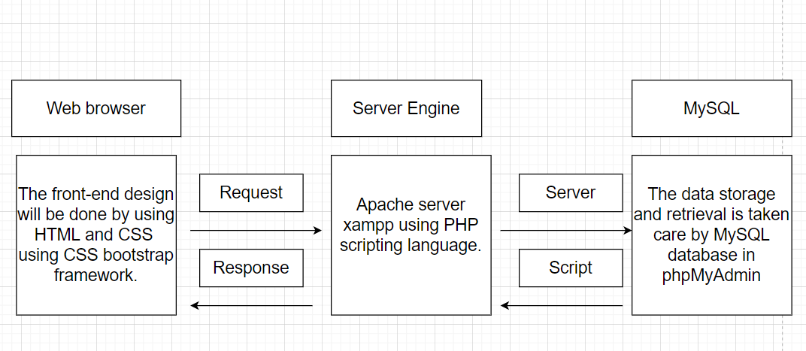
PROJECT DESIGN AND IMPLEMENTATION

Slide 24
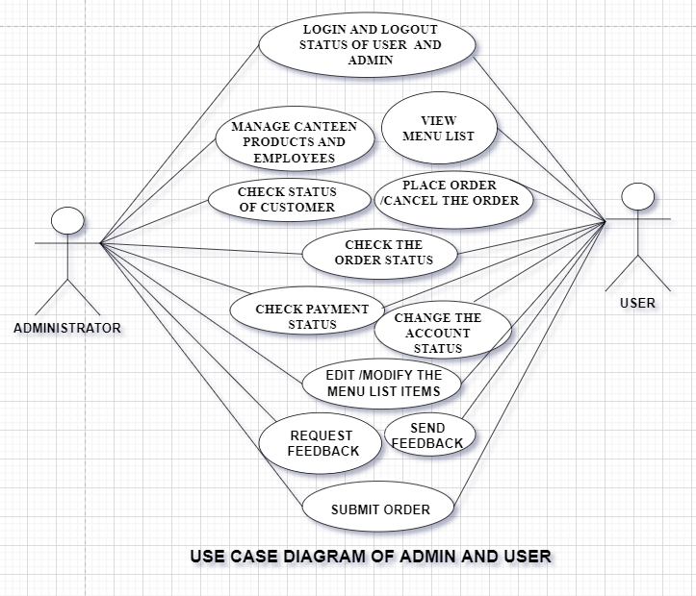
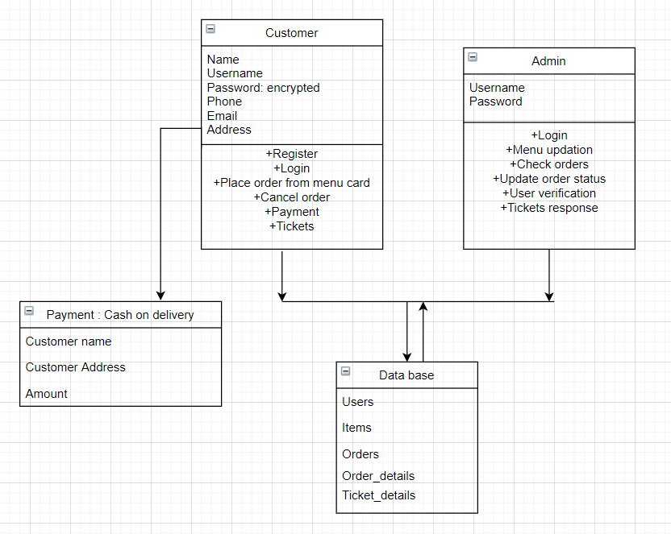
UML DIAGRAMS

Slide 25
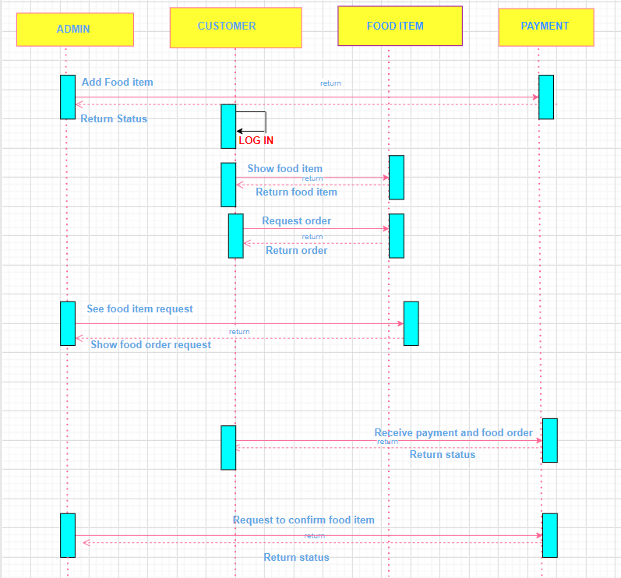
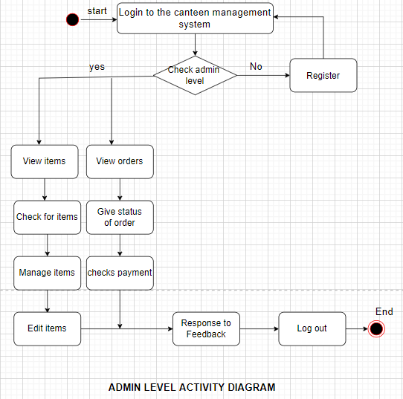

Slide 26
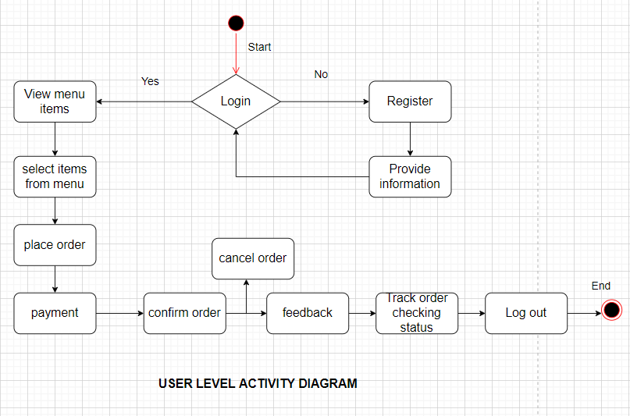
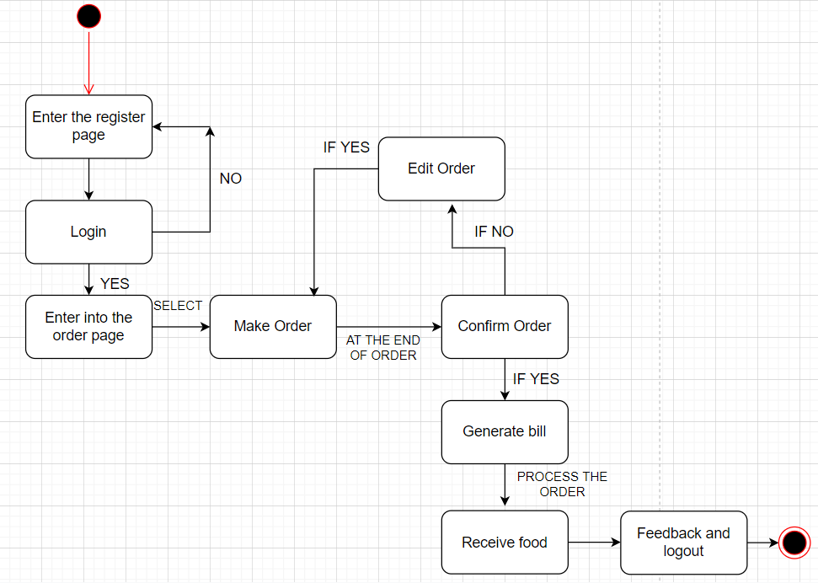

Slide 27
ADVANTAGES AND CONCLUSION
We can have track of orders and we can cook the food based on customer satisfaction and we get feedback after delivery of food in application so the Chef can cook according to customer satisfaction.
This system is convenient, effective and easy thereby improving the performance of canteen. It will also provide quality of service and customer satisfaction.
Overall conclusion is that, this is a fabulous CANTEEN MANAGEMENT system for the canteens, made by combining the web technology.

Slide 28
EXECUTION OF OUR PROJECT

Slide 29
THANK YOU!

